Slide 1


DIGITAL LOGIC
TOPIC : N-BIT ADDER & SUBTRACTOR
MADE BY-:
ASVK VINAYAK-1941012434
GITESH PANDEY- 1941012459
JYOTIADITYA PRASAD-1941012458
NIKHIL SAHU-1941012581
SAMBIT SOURAV PAL-1941012309

Slide 2
CONTENT
N-Bit Adder
The N-bit Adder is simply implemented by connecting 1 Half Adder and N-1 Full Adder in series. The Verilog code for N-bit Adder is designed so that the N value can be initialized independently for each instantiation. To do it, the Verilog code for N-bit Adder uses Generate Statement in Verilog to create a chain of full adders for implementing the N-bit Adder.
N-Bit SUBTRACTOR
The N-bit Subtractor is simply implemented by connecting 1 Half Subtractor and N-1 Full Subtractor in series. The Verilog code for N-bit Subtractor is designed so that the N value can be initialized independently for each instantiation. To do it, the Verilog code for N-bit Subtractor uses Generate Statement in Verilog to create a chain of full subtractor for implementing the N-bit Subtractor.

Slide 3
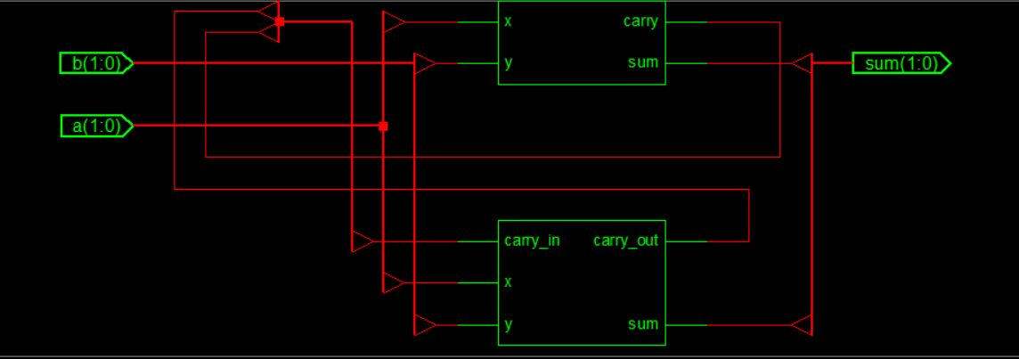
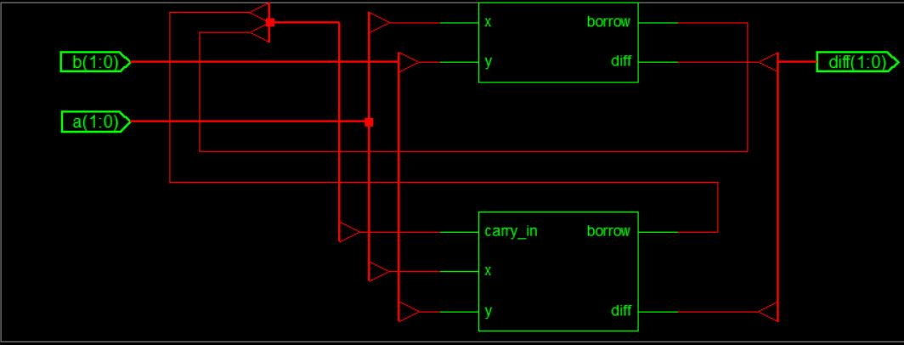
CIRCUIT DIAGRAM
2-BIT ADDER CIRCUIT DIAGRAM
2-BIT SUBTRACTOR CIRCUIT DIAGRAM

Slide 4
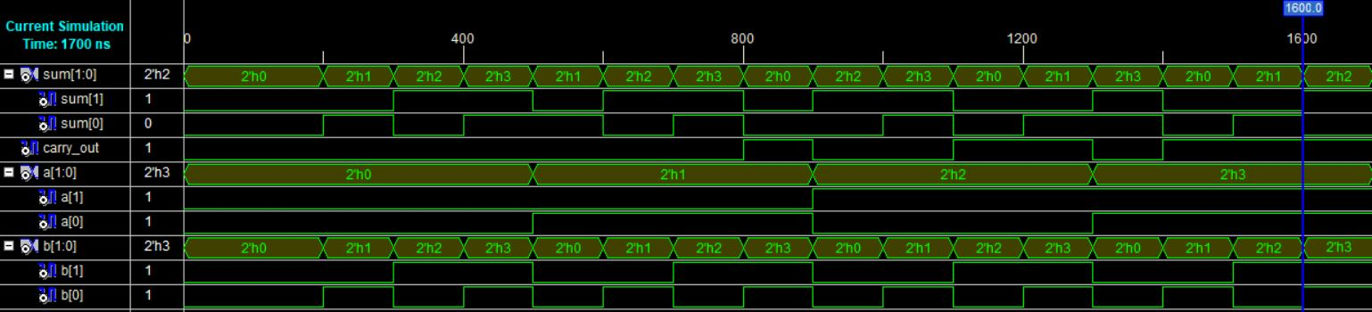
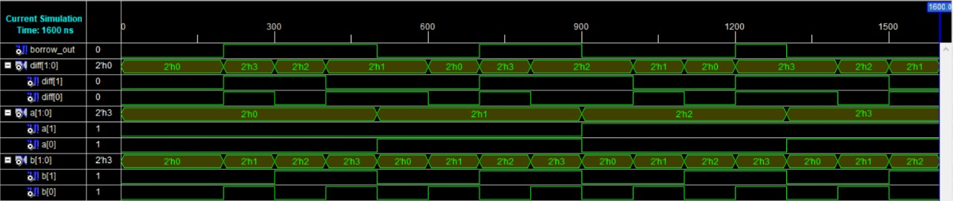
TEST BENCH WAVE-FORM
2-BIT ADDER
2-BIT SUBTRACTOR

Slide 5
TRUTH TABLE OF 2-BIT ADDER
TRUTH TABLE OF 2-BIT SUBTRACTOR
a1 | a0 | b1 | b0 | c | s1 | s0
0 | 0 | 0 | 0 | 0 | 0 | 0
0 | 0 | 0 | 1 | 0 | 0 | 1
0 | 0 | 1 | 0 | 0 | 1 | 0
0 | 0 | 1 | 1 | 0 | 1 | 1
0 | 1 | 0 | 0 | 0 | 0 | 1
0 | 1 | 0 | 1 | 0 | 1 | 0
0 | 1 | 1 | 0 | 0 | 1 | 1
0 | 1 | 1 | 1 | 1 | 0 | 0
1 | 0 | 0 | 0 | 0 | 1 | 0
1 | 0 | 0 | 1 | 0 | 1 | 1
1 | 0 | 1 | 0 | 1 | 0 | 0
1 | 0 | 1 | 1 | 1 | 0 | 1
1 | 1 | 0 | 0 | 0 | 1 | 1
1 | 1 | 0 | 1 | 1 | 0 | 0
1 | 1 | 1 | 0 | 1 | 0 | 1
1 | 1 | 1 | 1 | 1 | 1 | 0
a1 | a0 | b1 | b0 | b | d1 | d0
0 | 0 | 0 | 0 | 0 | 0 | 0
0 | 0 | 0 | 1 | 1 | 1 | 1
0 | 0 | 1 | 0 | 1 | 1 | 0
0 | 0 | 1 | 1 | 1 | 0 | 1
0 | 1 | 0 | 0 | 0 | 0 | 1
0 | 1 | 0 | 1 | 0 | 0 | 0
0 | 1 | 1 | 0 | 1 | 1 | 1
0 | 1 | 1 | 1 | 1 | 1 | 0
1 | 0 | 0 | 0 | 0 | 1 | 0
1 | 0 | 0 | 1 | 0 | 0 | 1
1 | 0 | 1 | 0 | 0 | 0 | 0
1 | 0 | 1 | 1 | 1 | 1 | 1
1 | 1 | 0 | 0 | 0 | 1 | 1
1 | 1 | 0 | 1 | 0 | 1 | 0
1 | 1 | 1 | 0 | 0 | 0 | 1
1 | 1 | 1 | 1 | 0 | 0 | 0

Slide 6
CONCLUSION
From the above we can make N-bit adder and subtractor.
THANK YOU

